Slide 1
IDENTIFYING SMART CITIES IN CANADA

Slide 2
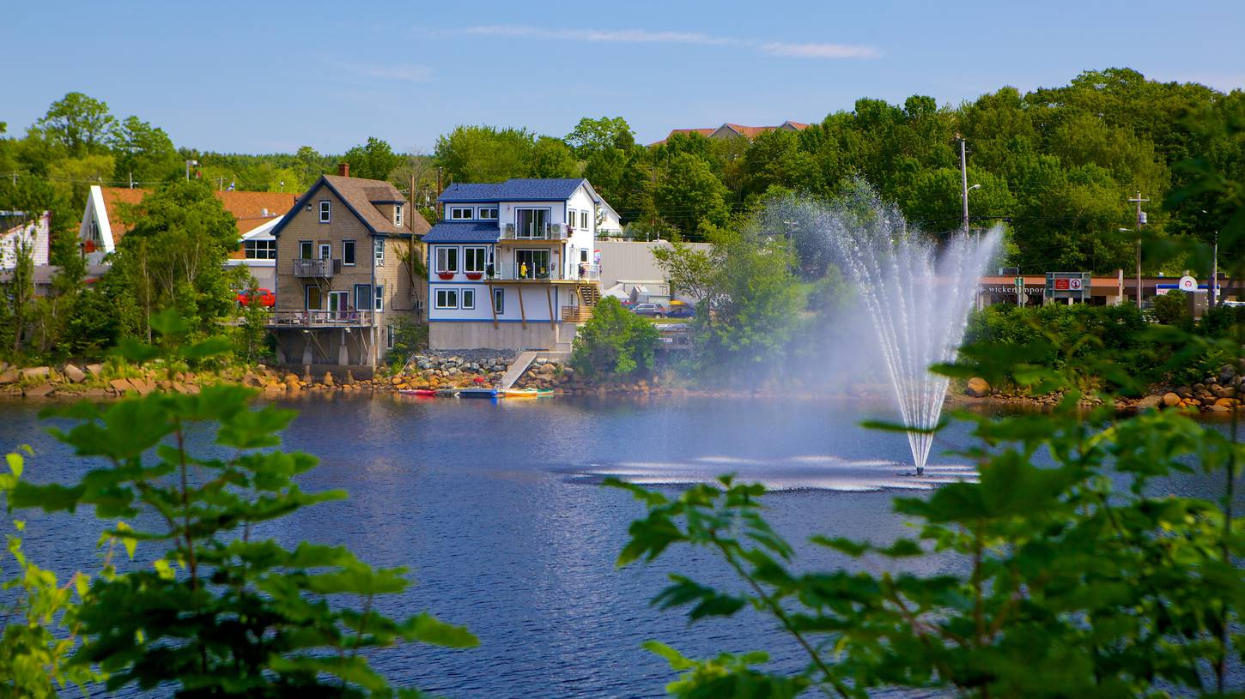

What is a smart city?
“Smart cities approach aims to achieve meaningful outcomes for residents by leveraging the fundamental benefits that data and connected technology have to offer” – (INFCC Application Guide)

Slide 3
Solution
Web Application available to all cities
Helps cities identify focus areas of growth
Notes:
We used a statistical model to

Slide 4
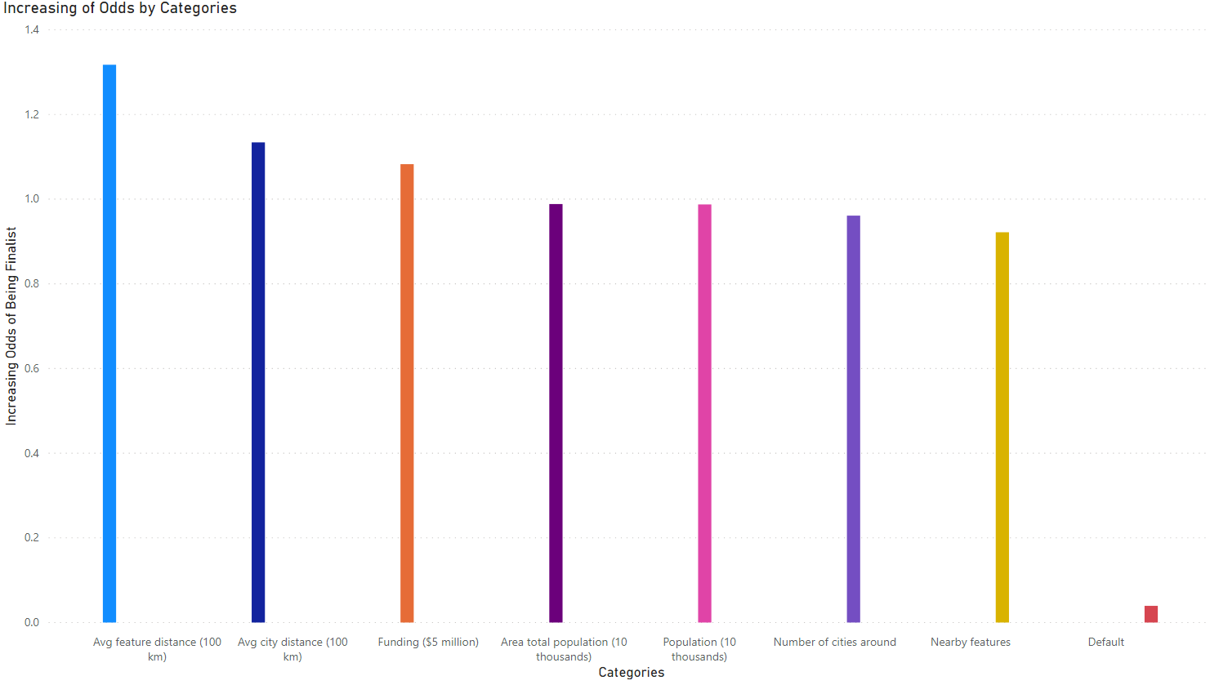
Our Model – Input / Output
Notes:
HISTOGRAM!

Slide 5
Benefits
Strengthen potential for smart cities
Improve competition quality of smart cities challenge

Slide 6
Moving Forward
Improving model techniques
Better identifying key concepts
Notes:
We’re using a statistical tool but to improve this, we could improve techniques of the model to

Slide 7

Our Team!
Jean Loic Kandikandi BSc. Student Software Engineering (COOP) uOttawa
Jie Song MSc. Student Statistics uOttawa
Jane MacDonald PhD. Student Mathematics uOttawa
Sebastien Girard BSc. Student Software Engineering (COOP) uOttawa

Slide 8

EVOLVING SMARTER!

